Slide 1
The FEMALE reproductive system
Structures and Functions of

Slide 2
FUNCTIONS
Produce Sex Hormones
  Estrogen
  Progesterone
Produce and Store Ovum (Eggs)
Provide a nourishing environment for egg to grow to fetus.

Slide 3
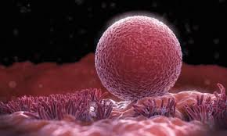
OVA or OVUM
The female reproductive cell.
Also known as the EGG.

Slide 4
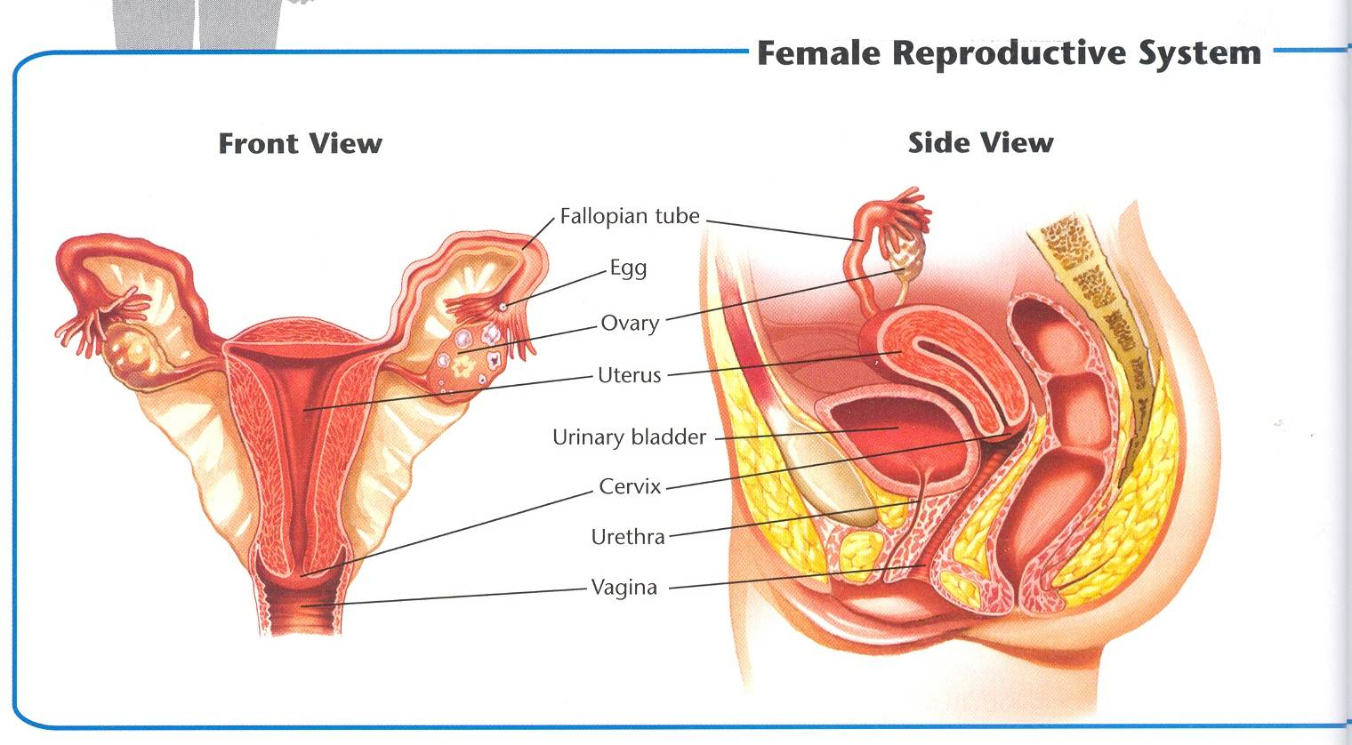

Slide 5
OVARIES
The female reproductive glands.
Stores ovum.

Slide 7
FALLOPIAN TUBES
The passageways that carry eggs from the ovaries to the uterus.
Can be tied for sterilization.

Slide 9
UTERUS
Hollow, muscular, pear-shaped organ.
Baby develops here.

Slide 11
CERVIX
Base of the uterus.
Dilates during pregnancy.

Slide 13
VAGINA
Hollow, Muscular
Passageway from uterus to outside world.

Slide 15
MENSTRUAL CYCLE
Process occurs when egg is not fertilized.
Uterine lining is shed and new cycle begins.

Slide 16
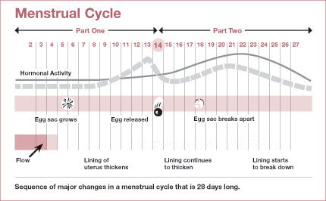

Slide 17
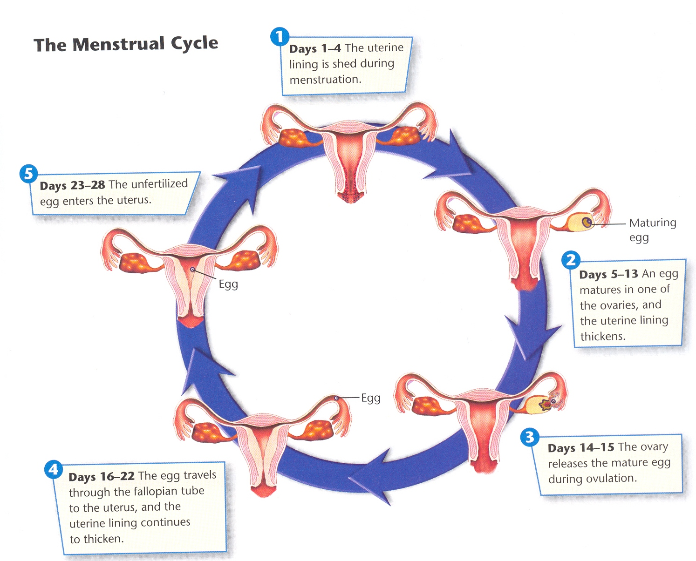
1
2
5
3
4

Slide 18
DAYS 1-4:
Uterine Lining is Shed. DAY 1 of Period.

Slide 19
DAYS 5-13:
Uterine Wall Thickens. Egg begins to mature.

Slide 20
DAYS 14-15:
OVULATION:
The mature egg is released into fallopian tube.

Slide 21
DAYS 16-22:
Egg travels through fallopian tube to uterus.
Uterine lining thickens more.

Slide 22
DAYS 23-28:
The unfertilized egg enters the uterus.

Slide 23


Slide 24
TICKET OUT
Name the organ where an embryo grows into a fetus.
On what day does a woman with a 30 day cycle ovulate??
Something you learned that you did not know before today.

